Slide 1
Reading guide:
Index:
Ratio between the size of the object to the size of the screen
A particular value
Dimension in inch unit
Function
Acronyms:
W/H
Width and Height ratio, calculate by actual dimension in inch unit
FS
Font size in point unit
FF
Font family
FSt
Font style
FC
Font color

Slide 2






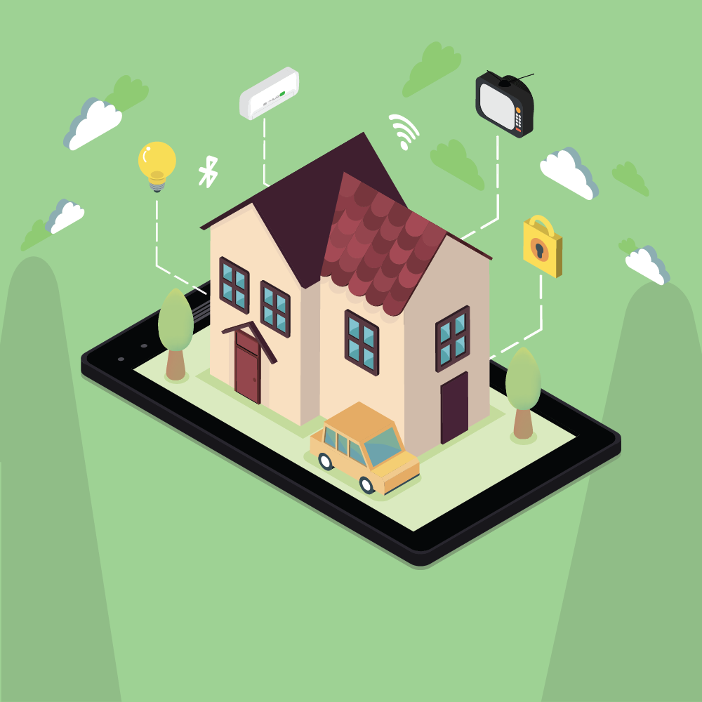
0.49
16:9 aspect screen ratio
GET STARTED
0.102
9:41
100%
9:41
100%
FS = 13pt
0.155
FF = Roboto Medium
FSt = Bold
Make your life easier!
Let’s begin now!
Make your life easier!
Let’s begin now!
Navigate to login page
0.13
Make your life easier!
Let’s begin now!
FS = 18pt
GET STARTED
GET STARTED
FF = Roboto Medium
0.102
FSt = Bold
Smart home intro animation
Lottie private link: https://lottiefiles.com/share/dda2mxcb

Slide 3





0.616
16:9 aspect screen ratio
Log in
0.09
9:41
100%
9:41
100%
FS = 12pt
Navigate to home page
FF = Roboto Medium
0.88
Email
0.089
0.03
Pasword
0.089
Email
Email
abc@sample.com
Email field
FS = 11pt
*******
Password field
FF = Roboto
Pasword
Pasword
Note: FC = #75816D for suggestion text, FC = Black for input text
Remember
FS = 10pt
Log in
Log in
FF = Roboto
Remember
Remember
Forget Password?
Remember
Forget Password?
Checked icon
Unchecked icon
Login background
Save the current login email
Create Account
FS = 10pt
Note: FC = #75816D when unfocus label, FC = #9C6742 when focus label
Don’t have Account?
Create Account
Don’t have Account?
Create Account
FF = Roboto
Note: FC = #75816D when unfocus label, FC = Black when focus label
Navigate to sign up page

Slide 4

0.616
16:9 aspect screen ratio
Create account
SIGN IN
0.09
9:41
100%
9:41
100%
FS = 12pt
FF = Roboto Medium
Create an account and return to login page
0.88
Email
0.089
0.03
Pasword
0.089
Email
Email
Refer to login page
Pasword
Pasword
Note: FC = #75816D when unfocus label, FC = Black when focus label
Confirm password
Confirm password
SIGN IN
SIGN IN
Create account
Create account
Sign up background

Slide 5

Background
16:9 aspect screen ratio
9:41
100%
9:41
100%
3.49”
=
+
6.2”
Bluetooth scanner screen background

Slide 6







Icons
0.129
0.129
16:9 aspect screen ratio
0.0725
0.0725
9:41
100%
9:41
100%
Note: in other screen ratio, the fraction is still the same, when calculate the width and height of the button, take the smaller value and make them equal each other (W/H = 1)
0.076
Navigate to previous page
Navigate to device manager page (Refer Hubs manager page)
0.3
0.087
W/H = 1.717
0.589
Bluetooth scanner animation
Toggle Bluetooth button, use to turn on and off bluetooth
W/H = 15/14
Bluetooth sate is off
Lottie private link: https://lottiefiles.com/share/kqbsb7y8
Bluetooth sate is on
Click to scan Smart Hub
Click to scan Smart Hub
0.087
FS = 14pt
Click to scan Smart Hub
FF = Roboto Medium
0.206
Suggestion text
Bluetooth scanner screen

Slide 7








Home
Remotes
Hubs
Info
SmartHub-B..
FF = Roboto Medium
FS = 8pt
16:9 aspect screen ratio
Connected
FF = Roboto
FS = 6pt
Note: Refer Home page
10 CR
FF = Roboto
FS = 6pt
9:41
100%
9:41
100%
0.076
0.17
0.129
0.129
FF = Roboto
FSt = Bold
FS = 10pt
0.095
0.0725
0.0725
SmartHub-B..
MyHub
SmartHub-B..
MyHub
0.318
W/H = 1
Connected
Disconnected
Connected
Disconnected
Note: in other screen ratio, the fraction is still the same, when calculate the width and height of the button, take the smaller value and make them equal each other (W/H = 1)
Navigate to SmartHub scanner page
10 CR
2 CR
10 CR
2 CR
0.18
Navigate to previous page
Edit hubs manager page
0.776
Navigate to Add new hub page
0.318
W/H = 1
SmartHub-B..
SmartHub-B..
1
Connected
Connected
0.18
2
10 CR
10 CR
3
0.071
0.1432
0.148
1
Device name
Home
Remotes
Hubs
Info
Home
Remotes
Hubs
Info
2
Device status
3
Current number of connected remote controller
Hub manager screen

Slide 8

Background
16:9 aspect screen ratio
9:41
100%
3.49”
=
+
6.2”
Bluetooth scanner screen background

Slide 9







Icons
0.129
0.129
16:9 aspect screen ratio
0.0725
0.0725
9:41
100%
9:41
100%
Note: in other screen ratio, the fraction is still the same, when calculate the width and height of the button, take the smaller value and make them equal each other (W/H = 1)
0.076
Navigate to previous page
Navigate to device manager page (Refer Hubs manager page)
0.3
0.087
W/H = 1.717
0.589
Bluetooth scanner animation
Toggle Bluetooth button, use to turn on and off bluetooth
W/H = 15/14
Bluetooth sate is off
Bluetooth sate is on
Click to scan Smart Hub
Click to scan Smart Hub
0.087
FS = 14pt
Click to scan Smart Hub
FF = Roboto Medium
0.206
Suggestion text
Bluetooth scanner screen

Slide 10







SmartHub-B..
FF = Roboto Medium
FS = 8pt
16:9 aspect screen ratio
Home
Remotes
Hubs
Info
Connected
FF = Roboto
FS = 6pt
Note: Refer Home page
10 CR
FF = Roboto
FS = 6pt
9:41
100%
9:41
100%
0.076
0.17
0.129
0.129
FF = Roboto
FSt = Bold
FS = 10pt
0.095
0.0725
0.0725
SmartHub-B..
MyHub
SmartHub-B..
MyHub
0.318
W/H = 1
Connected
Disconnected
Connected
Disconnected
Note: in other screen ratio, the fraction is still the same, when calculate the width and height of the button, take the smaller value and make them equal each other (W/H = 1)
Navigate to SmartHub scanner page
10 CR
2 CR
10 CR
2 CR
0.18
Navigate to previous page
Edit hubs manager page
0.776
Navigate to Add new hub page
0.318
W/H = 1
SmartHub-B..
SmartHub-B..
1
Connected
Connected
0.18
2
10 CR
10 CR
3
0.071
0.1432
0.148
1
Device name
Home
Remotes
Hubs
Info
Home
Remotes
Hubs
Info
2
Device status
3
Current number of connected remote controller
Hub manager screen

